Slide 1
What’s the Point…
with special guest
of Encouraging & Tracking Giving?
Thursday, April 29 - 2pm Central
Making Ministry Easy With TouchPoint’s Solutions

Slide 2
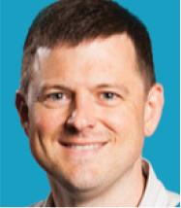
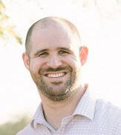
Presenters
Brent Spicer Executive Vice President | Andrew Triplett Director of Consulting

Slide 3
Housekeeping
Submit Questions using Q&A Button in Control Panel

Slide 4
Agenda
How To Engage & Retain New Visitors Going Into Summer
Giving Has Stabilized -- But Only For The Top 10% Of Givers
How Do We Encourage New Givers?
Effectively Track Givers & Moving Through Tiers Of Giving
What Is Effective Segmentation For Our Givers?

Slide 5
How To Engage & Retain New Visitors Going Into Summer

Slide 6
Engaging New Summer Visitors
Identify their stage in life and connect at that level.
Example: If a family attends for the first time – have a children’s pastor send a "Thank you” for visiting card and encourage them to attend an upcoming outreach event.
Don’t overwhelm them with too many opportunities, but give them at least 1 reason to attend again.
Send email communication on an upcoming Welcome Event.
Use text messaging to send a quick follow-up message, include a $5 gift card in your text and remember to include a link for prayer.

Slide 7
First-Time Givers
Look back 1-year and track how many NEW Givers you’ve acquired and retained.
How much of their giving was retained over the last year?

Slide 8
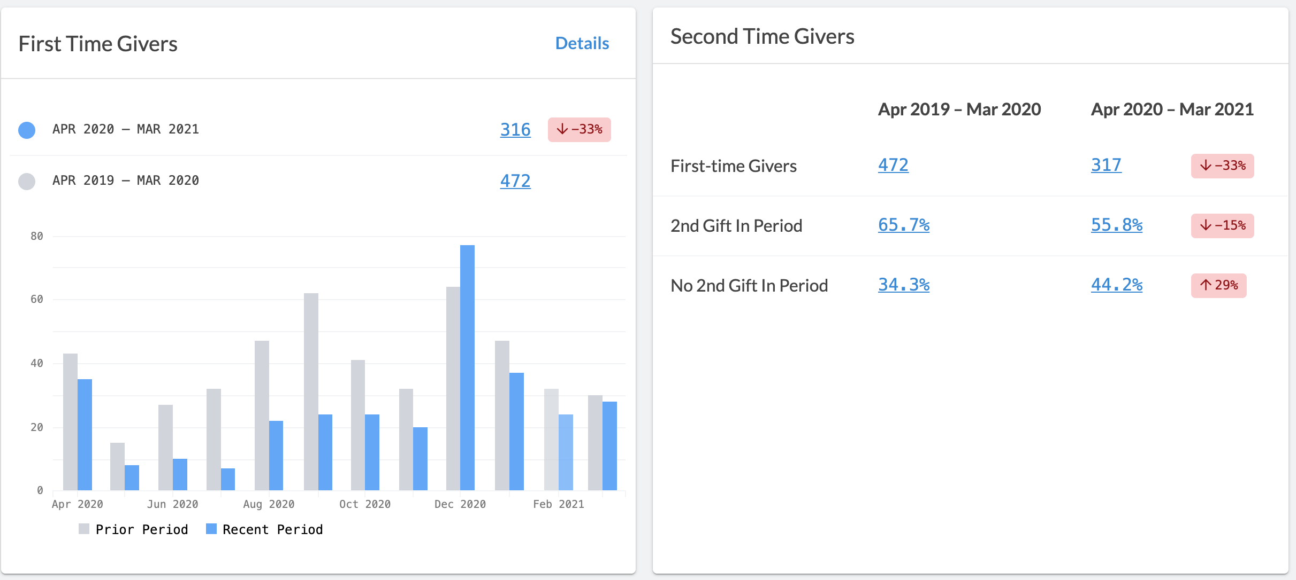

Slide 9
First-Time Givers
If your retention is under 30%, then what can you do to retain more NEW givers?
Evaluate Assimilation Processes
Are You Thanking First-time, Second-time and Third-time Givers?
Is Someone on Staff Reaching Out to Build Relationships?
Do Your First-Time Givers Know What Ministries the Church Offers?
Communications should be targeted relationally by each ministry.
Stewardship should COVER all ministries. INVOLVE your whole team!

Slide 10
Giving Has Stabilized – But Only For The Top 10% Of Givers

Slide 11
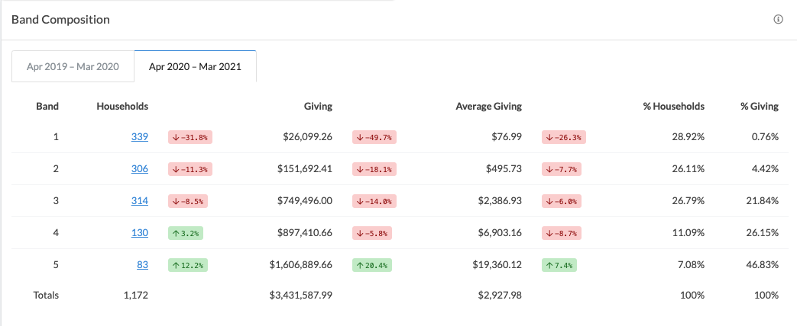
Retain Current Givers
Retain Current Givers

Slide 12
Retain Current Givers
Look back 1-year and track how many CORE Givers you’ve retained.
How much of their giving was retained over the last year?

Slide 13
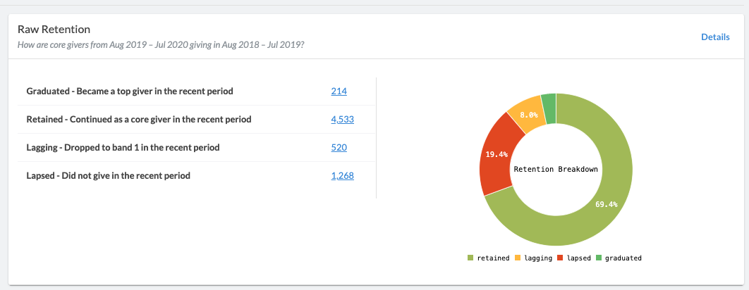
Retain Current Givers
Retain Current Givers

Slide 14
Retain Current Givers
What can you do to retain more CORE givers?
Thank CORE Givers quarterly
Have Pastors reach out to form a relationship
Get CORE Givers involved with ministry service
Have Pastors contact lapsed & lagging givers
Offer financial & generosity classes

Slide 15
How Do We Encourage New Givers?
&

Slide 16
Grow Financial Giving
Talk About Money
Cultivate Relationships
Share Compelling Stories
Get Them Plugged In
Cast Vision
Simply Ask
Make Giving Easy
Communicate Appreciation
Notes:
Source:
https://www.churchfuel.com/how-to-encourage-people-to-give-6-steps/
https://www.forbes.com/sites/forbesnonprofitcouncil/2018/08/23/nine-ways-to-convert-one-time-donors-to-regular-givers/?sh=28f497aa2df3

Slide 17
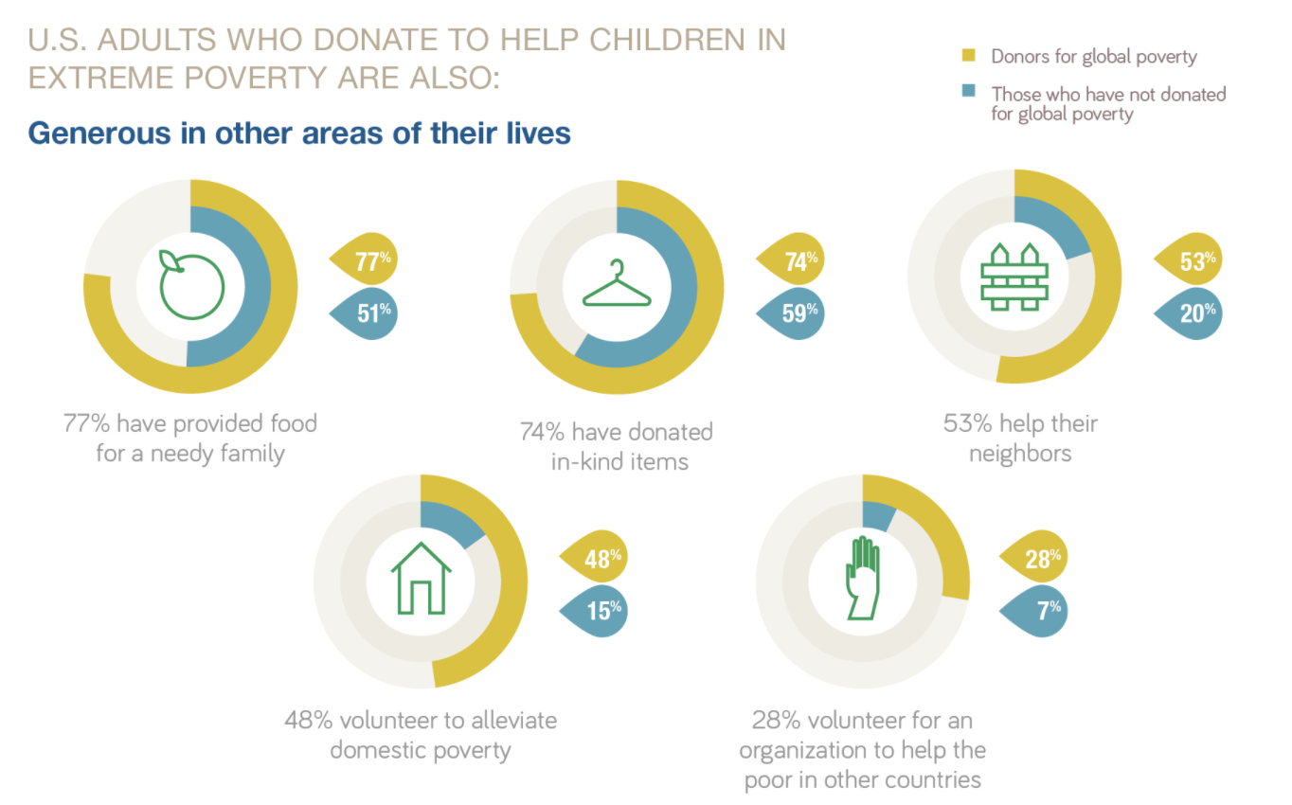
The More They Care, The More They Care
https://www.barna.com/research/generosity-infographic/

Slide 18
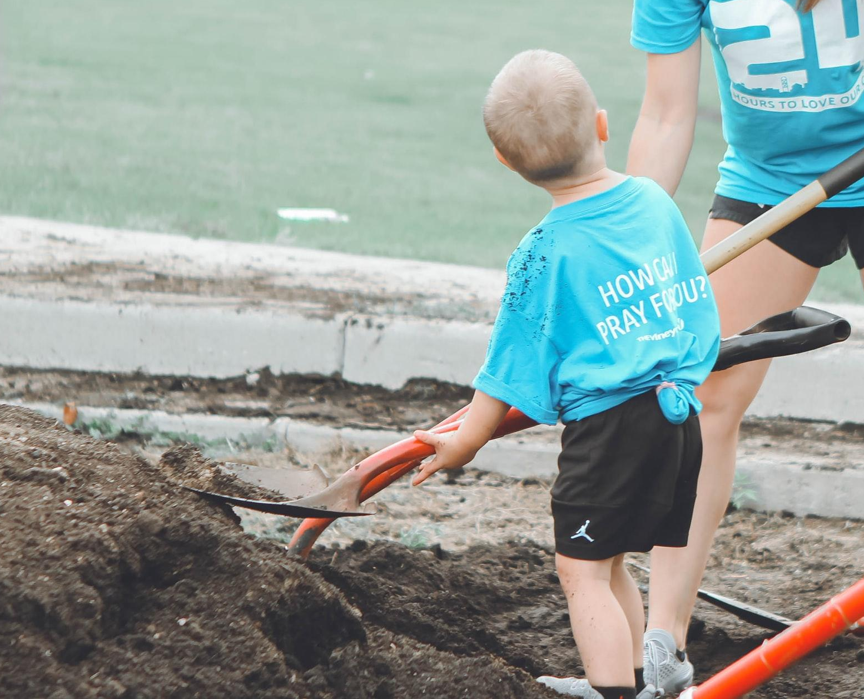
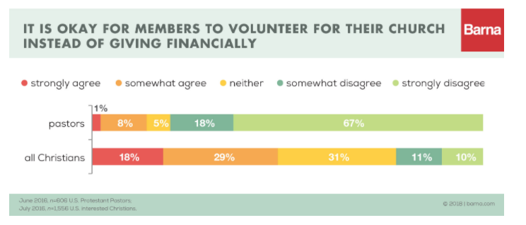
Get Them Involved
https://www.barna.com/wp-content/uploads/2018/08/Volunteering-for-the-Church-01.jpg
Christians who typically give most are also most likely to say they have volunteered within the past week or month.
Christians that actively participate in one type of giving aren’t looking to get a pass on the other.
Whether giving of money or of time, generous Christians are simply generous.

Slide 19
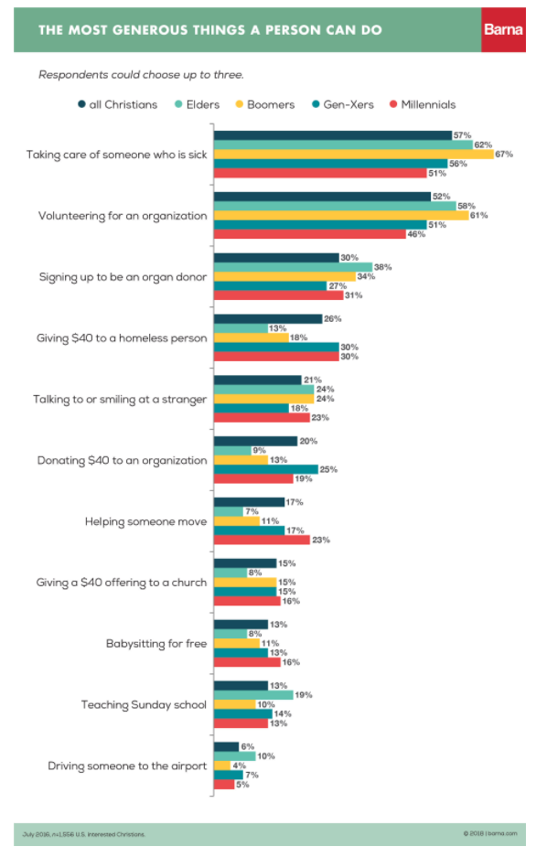
Get Them Involved
Many consider giving $40 to a person in need (like an unhoused person), more generous than giving $40 to an organization or church.
Even though the dollar amount is the same, the act of giving during a personal encounter rather than giving to their church when the offering plate is passed holds a different weight.
https://www.barna.com/wp-content/uploads/2018/08/Volunteering-for-the-Church-04.jpg
Notes:
Source:
https://www.barna.com/research/volunteering-giving/

Slide 20
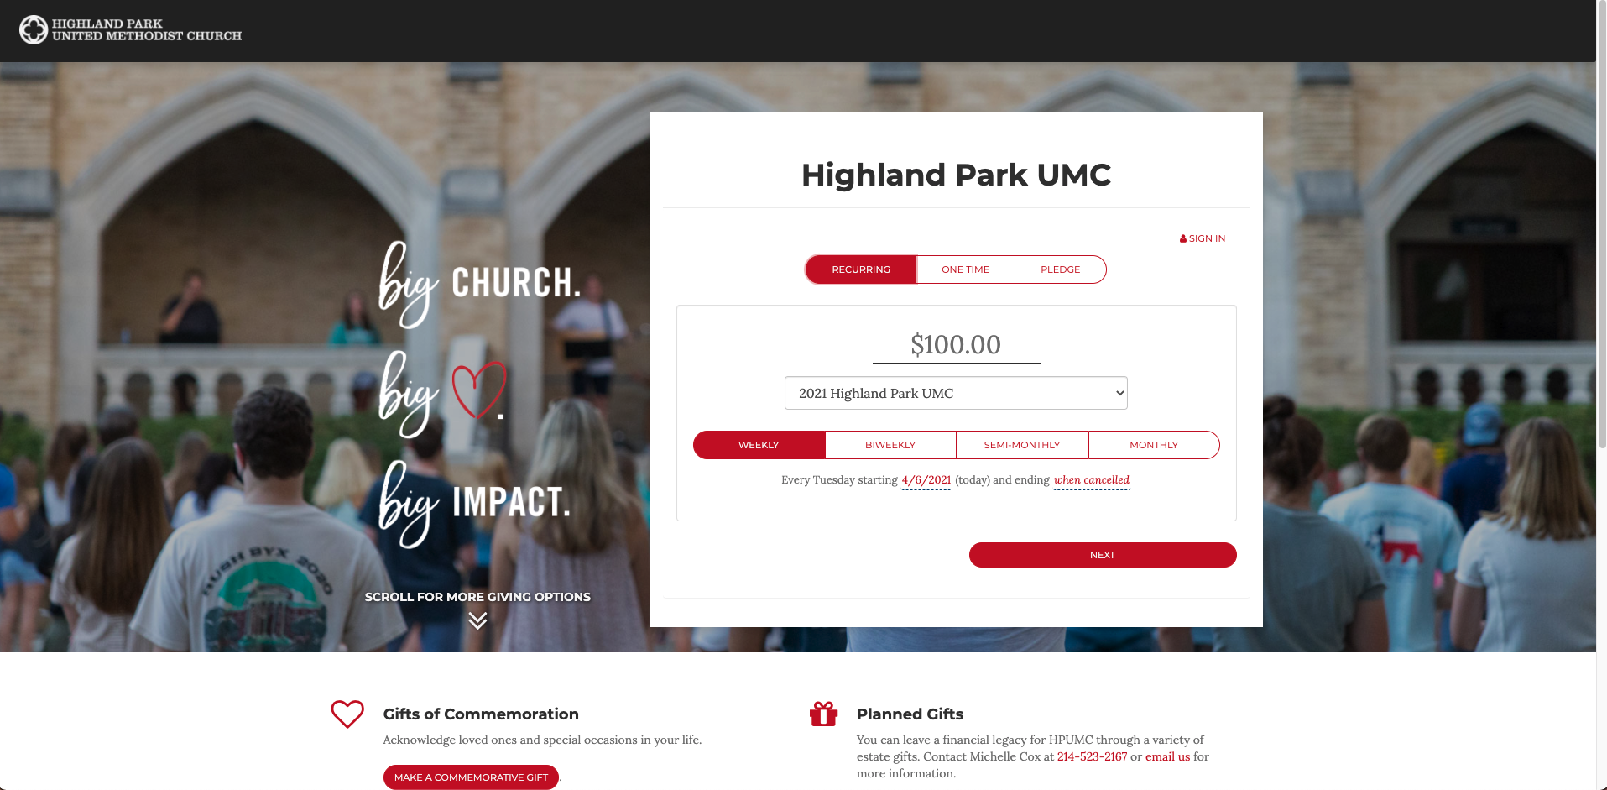
Online Giving Pages

Slide 21
Share Your Story. Engage with Mission.
What is Your Church’s Unique Story?
Do you have a Case for Support?
Why should people be giving to your church? What causes are you supporting and what is the greater vision for your church?
Review your Vision and Mission
Is your vision fully engrained in each area of ministry at your church?

Slide 22
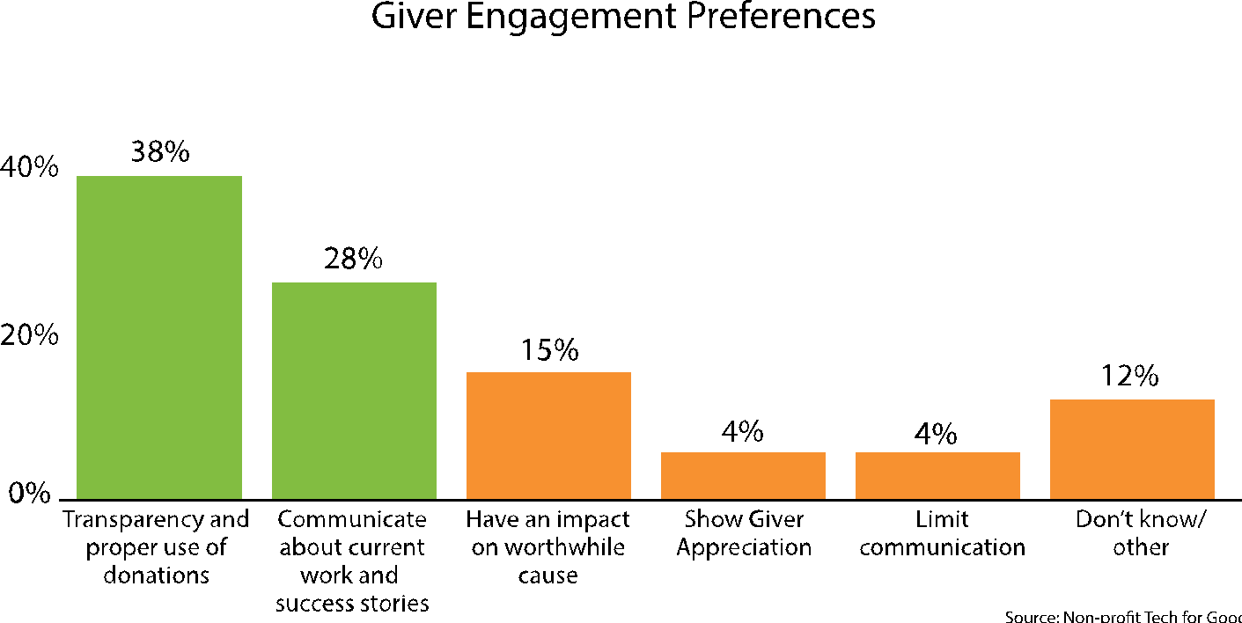
Share Your Story. Engage with Mission.

Slide 23
Share Your Story. Engage with Mission.
Vision should be evergreen
Vision is long-term
Regularly share the past direction, current successes and future opportunities to join.
Engage your givers with the overall mission of the church. Be transparent with what their giving supports.

Slide 24
Effectively Tracking Givers & Moving Through Tiers Of Giving

Slide 25
Set Goals For Where You Want To Be
Specific
Measurable
Achievable
Realistic
Timely

Slide 26
Measuring Givers
Widgets
Reports
Status Flags

Slide 27
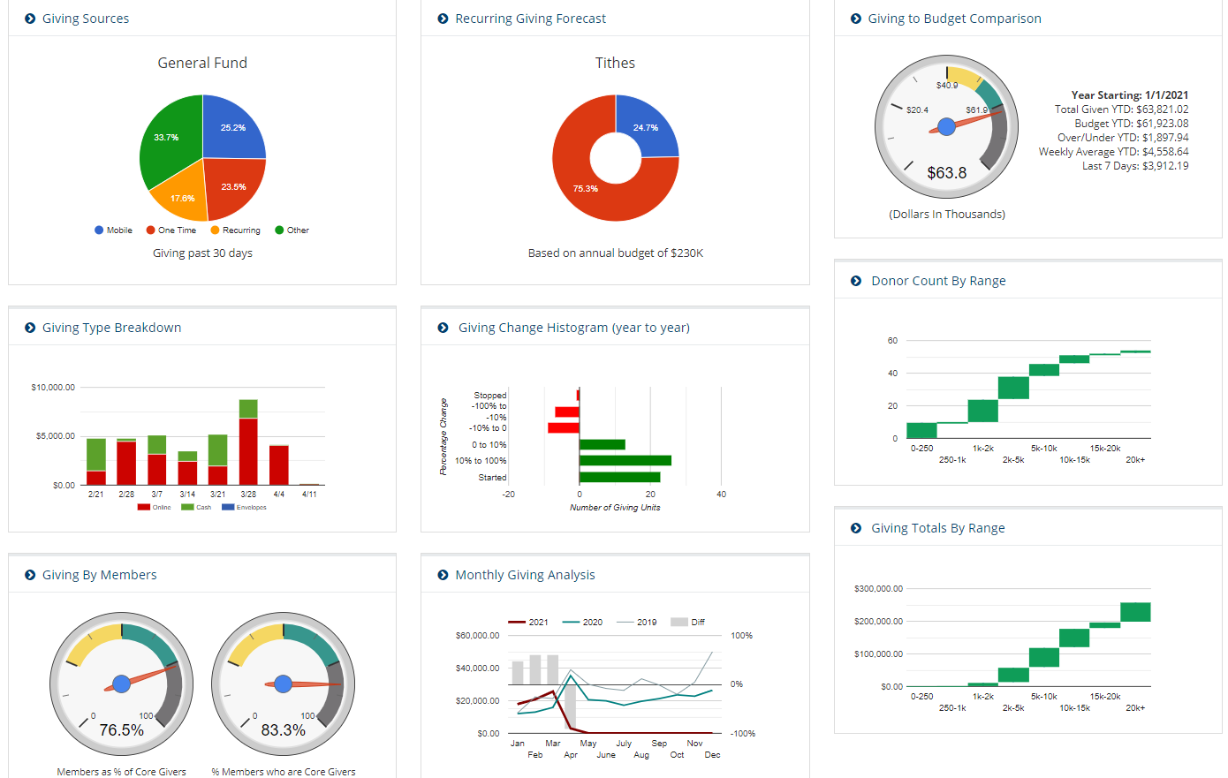
Widgets: Giving Dashboard

Slide 28
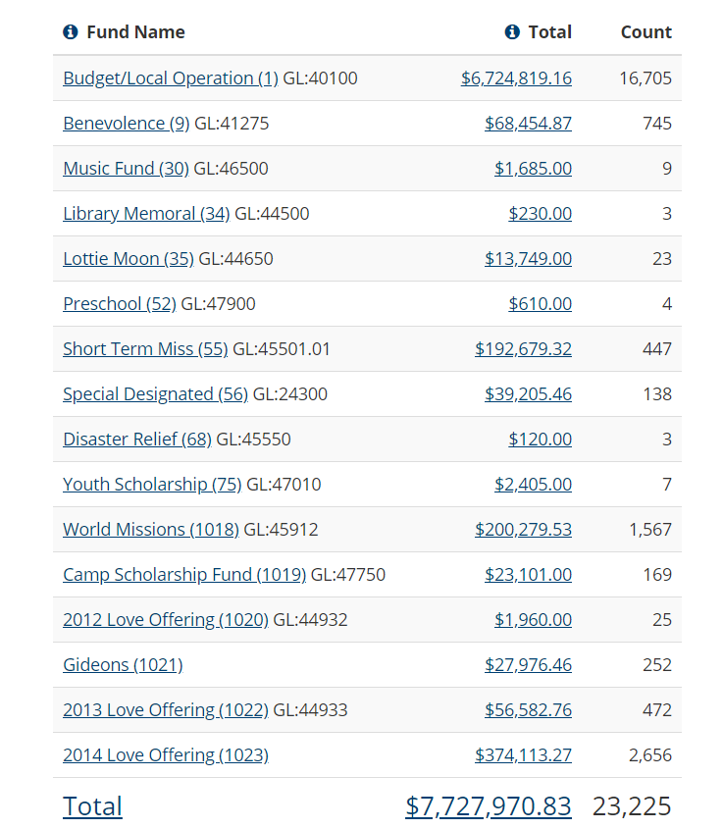
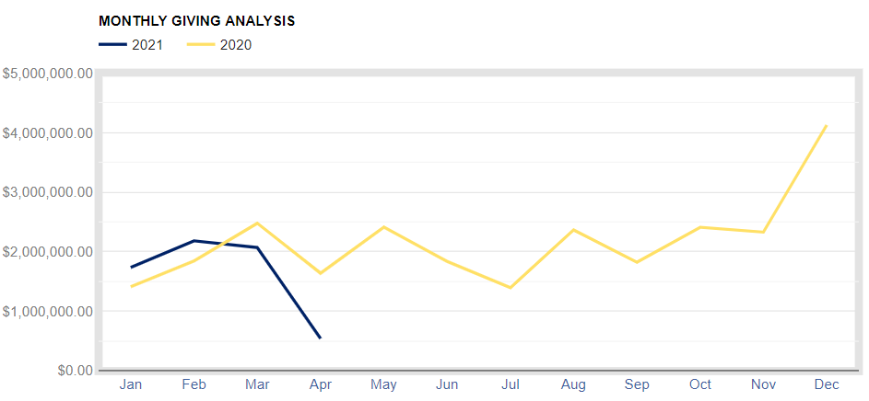
Reports

Slide 29
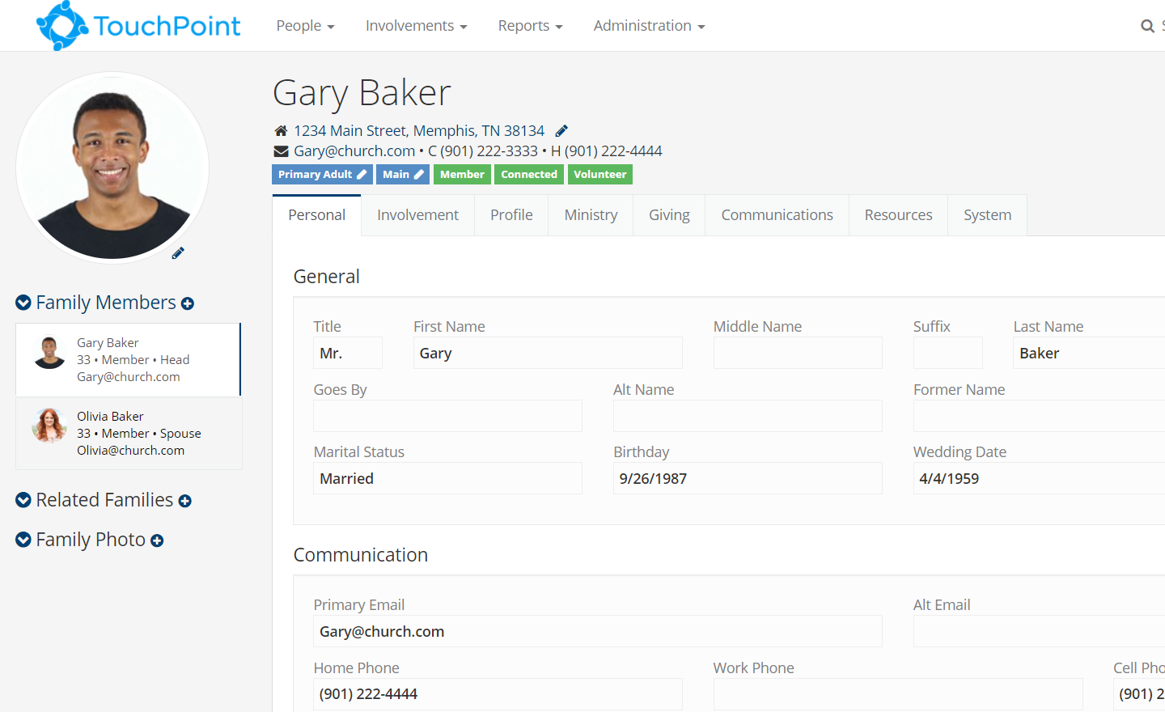
Status Flags
Tier 1, Tier 2, etc.
Recent Giver
First-Time Giver
Recently Stopped Giving

Slide 30
Elevating Givers
Under $1k
$1k - $5k
$5k - $10k
$10k - $25k
Above $25k
Adopt a Mobile-First Strategy
Start With “Bought In” People
Create A Pledge Campaign

Slide 31
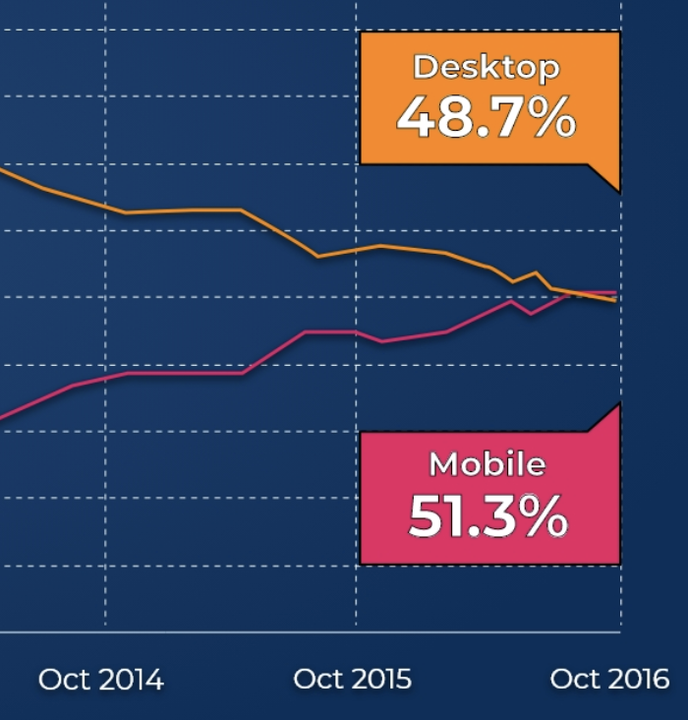
The Case For Mobile
1
4 hrs
Average Time Spent On Smartphones Per Day
Google Traffic From A Mobile Device In The US In 2019
People Who Have A Better Opinion Of Brands When They Offer Good Mobile Experience (HubSpot)
63%
61%

Slide 32
The Case For Mobile
1
$930B
40%
54%
Online Transactions Using A Mobile Device
Consumers Spending Using Mobile Payment
Applications
Predicted US Retail E-commerce from Mobile by 2021
(techjury)

Slide 33
The Case For Mobile
1
Mobile
Desktop
Easy To Use
Knows Who You Are (Securely)
Always With You
Not Always With You
Easy To Use
Not As Quick As Mobile

Slide 34
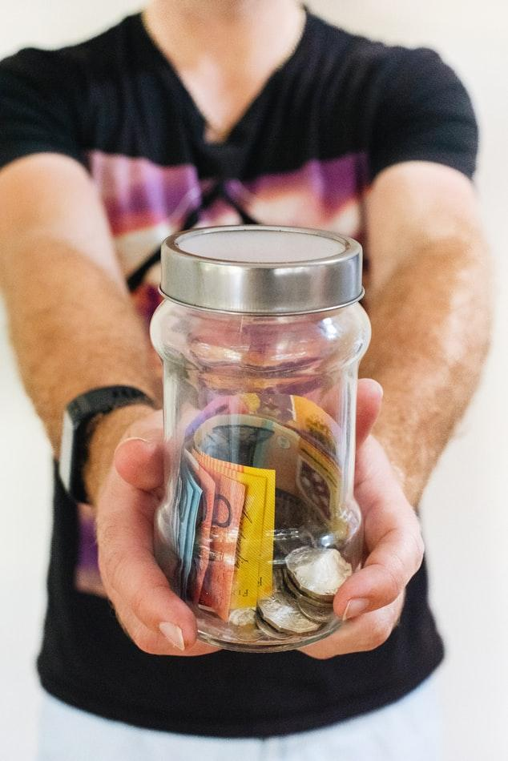
2
Start With Those Who Are “Bought In”
Staff
Elders + Diaconate
Lay Leaders
Members

Slide 35
3
Create A Pledge Campaign
General Fund
Annual Pledge Drive
Capital Campaign

Slide 36
What Is Effective Segmentation For Our Givers?

Slide 37
Segment Types
Giving Behavior
Church Involvement (Guest vs Member)
Life Stage
Volunteer Area
Leadership Position
Mission Trip Involvement

Slide 38
Segmenting by Giving Behavior
Consider targeting with a message about the spiritual discipline of giving
Consider targeting with an “upgrade” series
🤩
Non Givers
Sporadic
Cash/Check Regular
Online
Online Recurring

Slide 39
Segmenting Givers

Slide 40
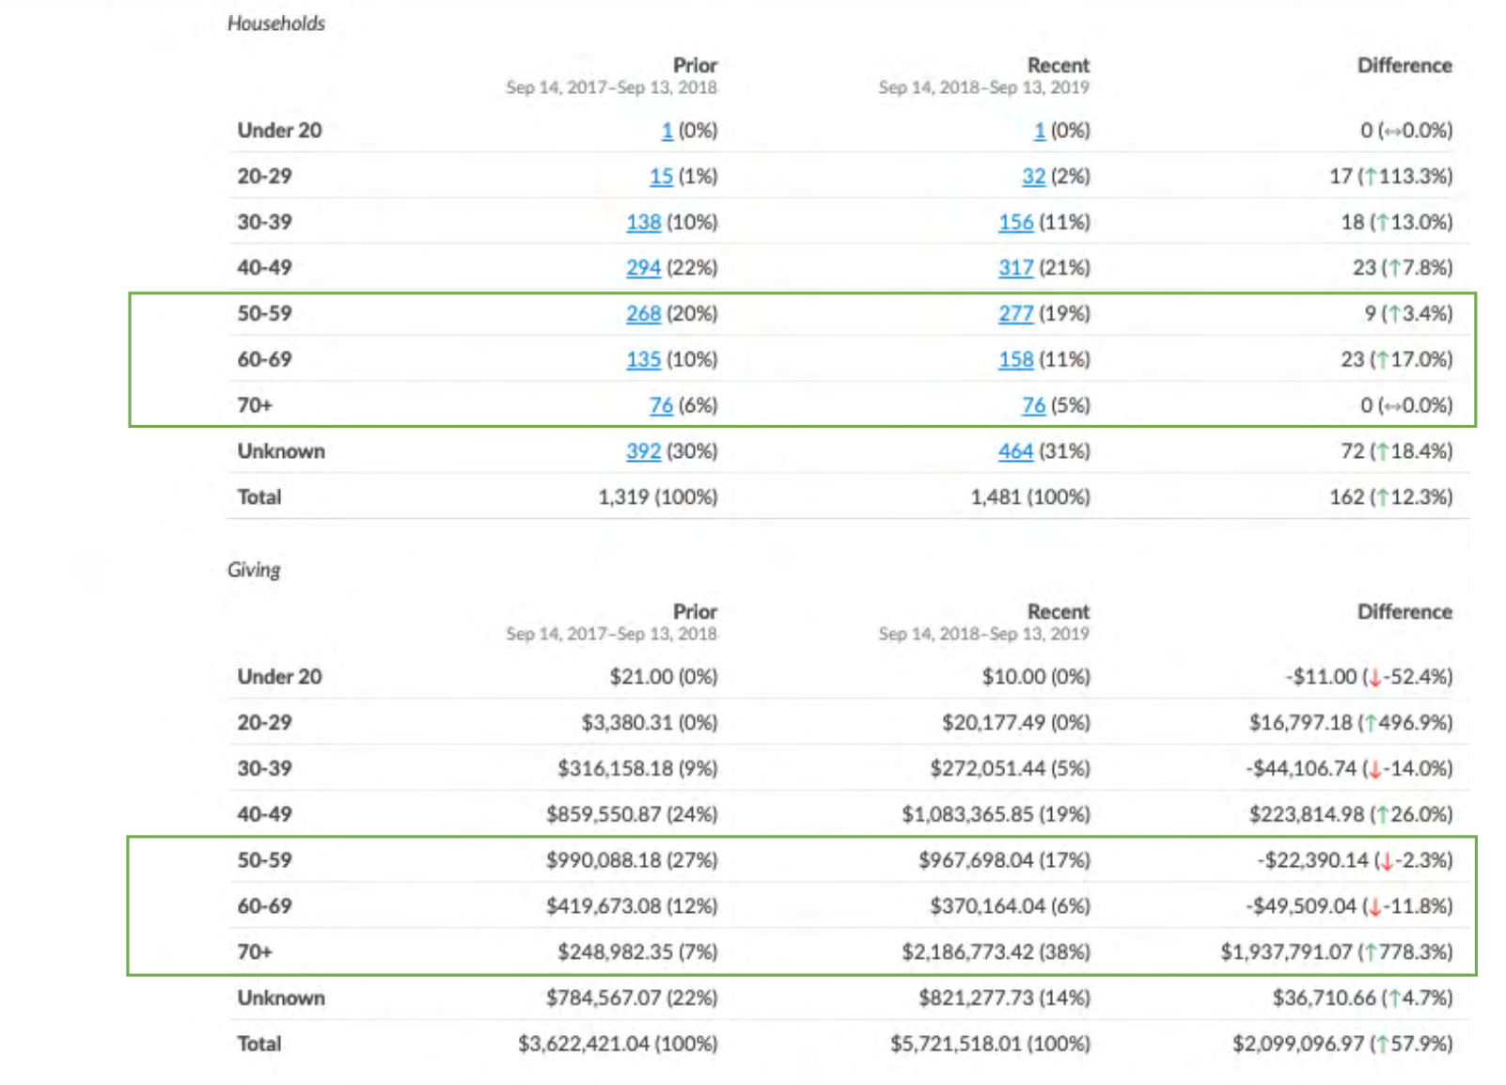

Slide 41
Build Relationships with Financial Leaders

Slide 42
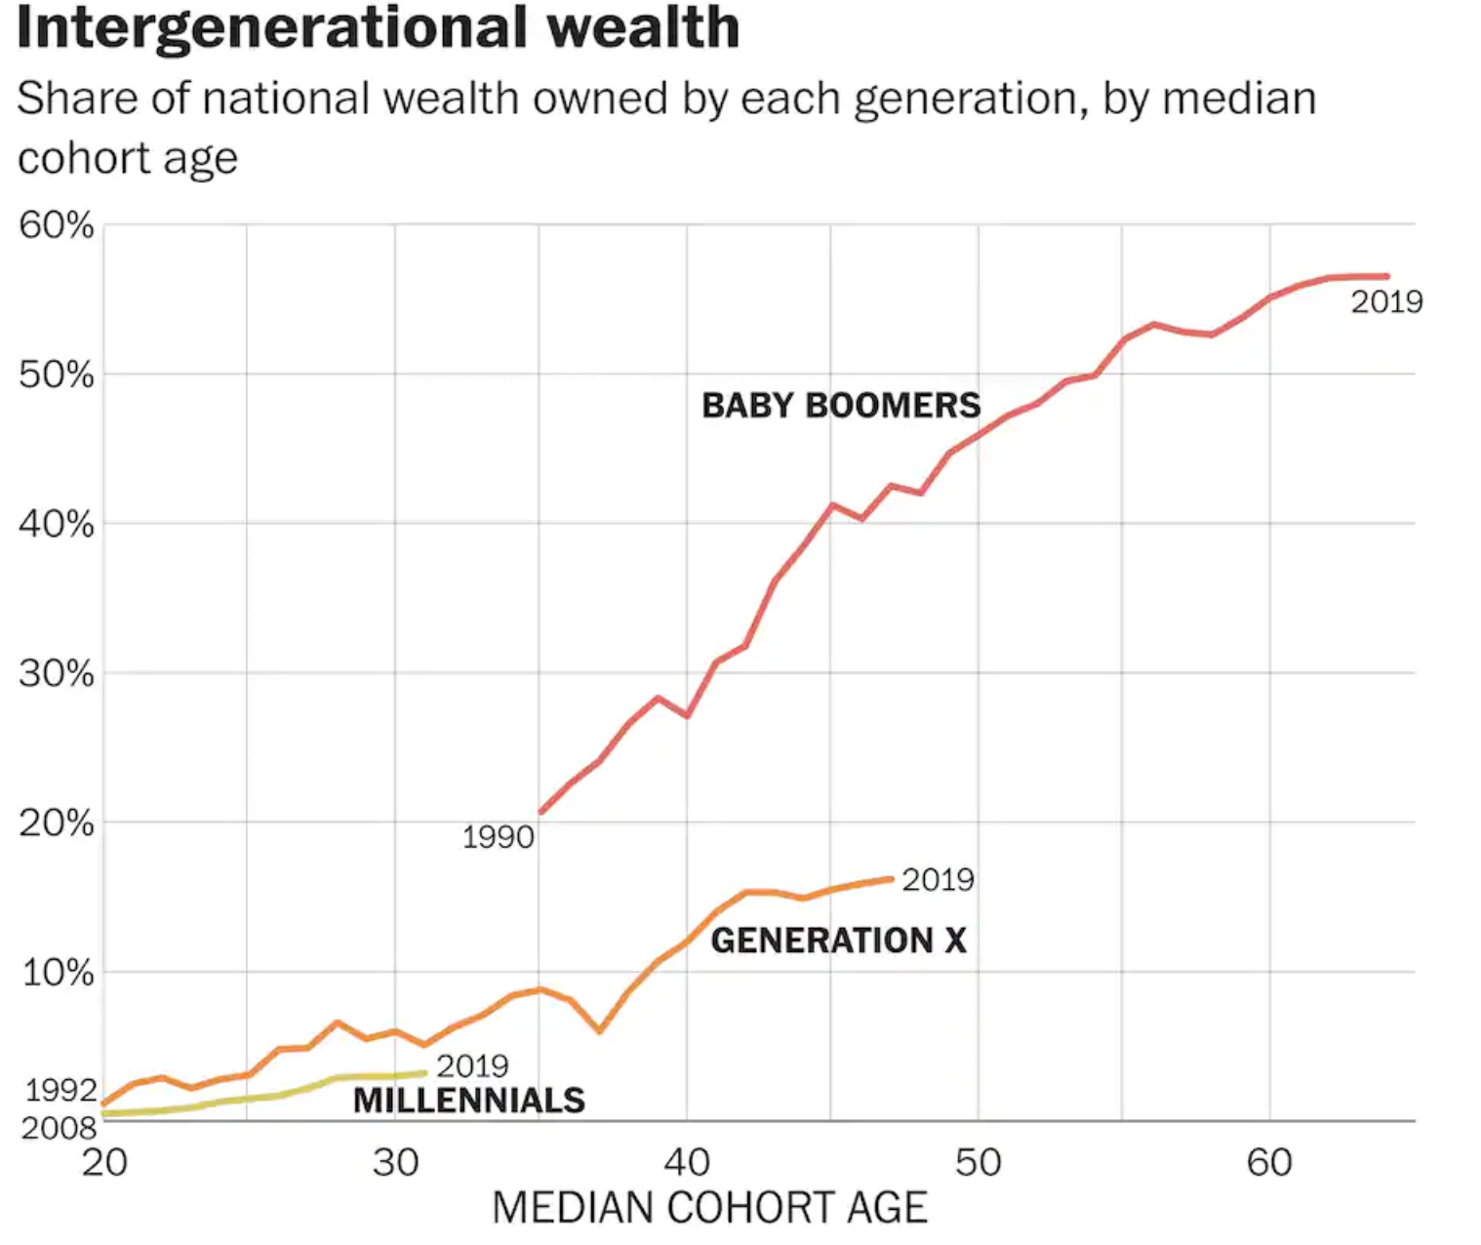
Build Relationships with Financial Leaders

Slide 43
Build Relationships with Financial Leaders
Giving to religious institutions only increased by .5% from 2019, making it the only charitable institution that have relatively flat financial growth.
Source: Giving USA 2020 Annual Report

Slide 44
Build Relationships with Financial Leaders
Build personal relationships with Financial Leaders
Invite Financial Leaders to participate in vision planning & legacy lanes
Host classes & events specifically for Financial Leaders that teach gift planning, legacy giving, and financial stewardship.
Teach Financial Leaders how to give long-term sustainable gifts

Slide 45
Good Communication =
Sending the Right Message to the Right People at the Right Time

Slide 46
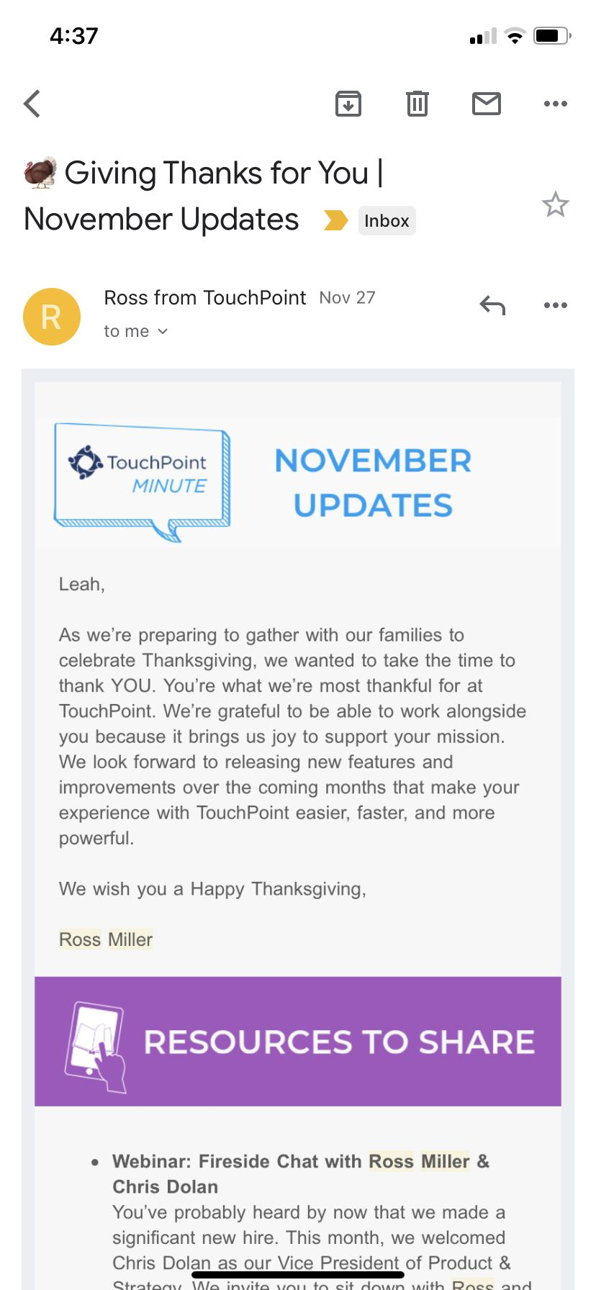
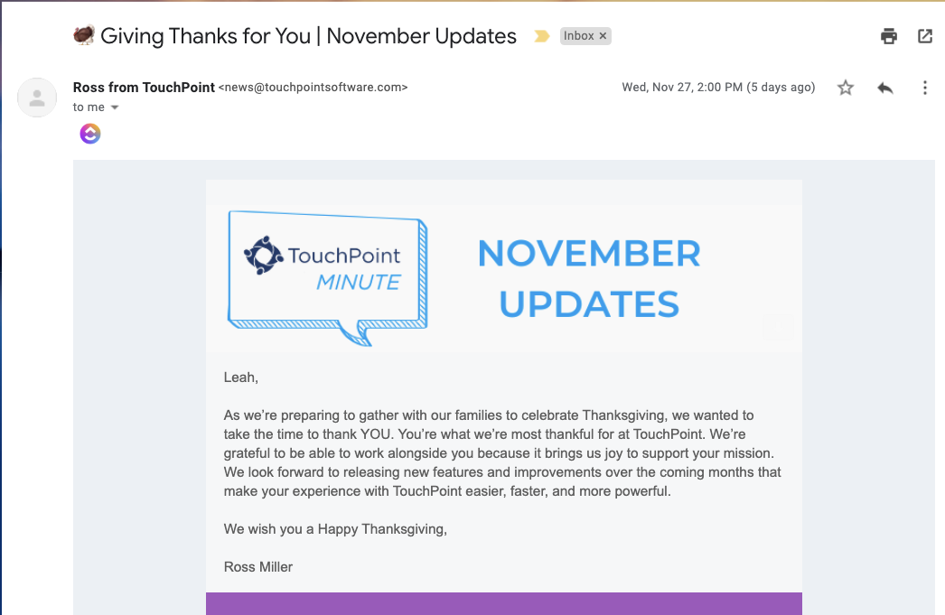
MOBILE RESPONSIVE

Slide 47
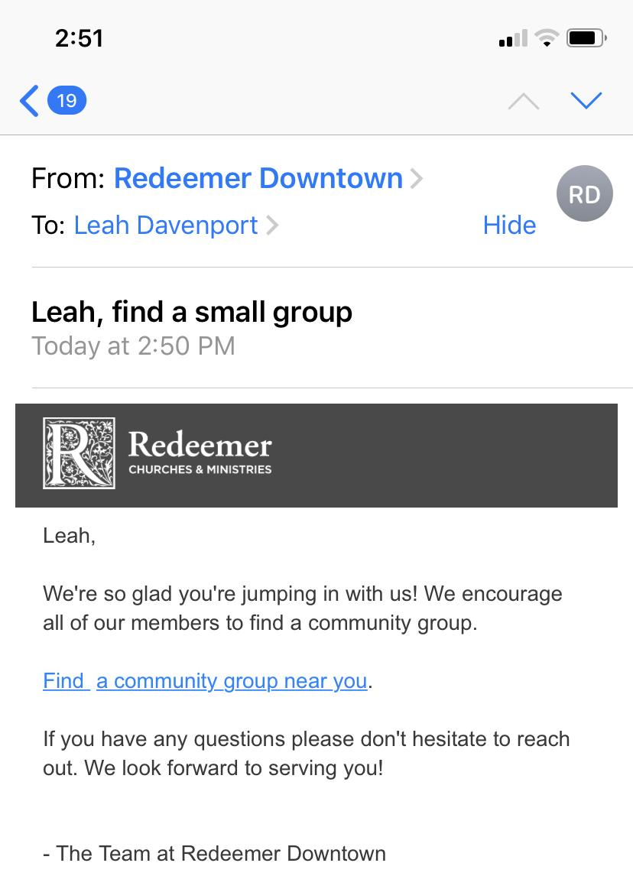
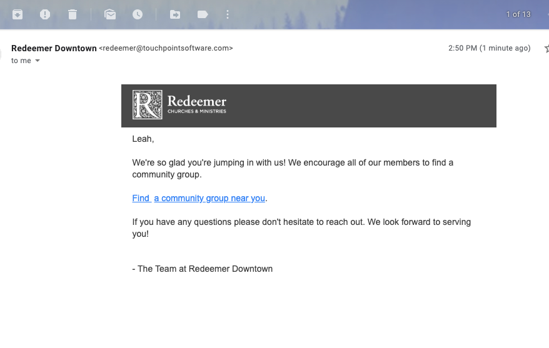
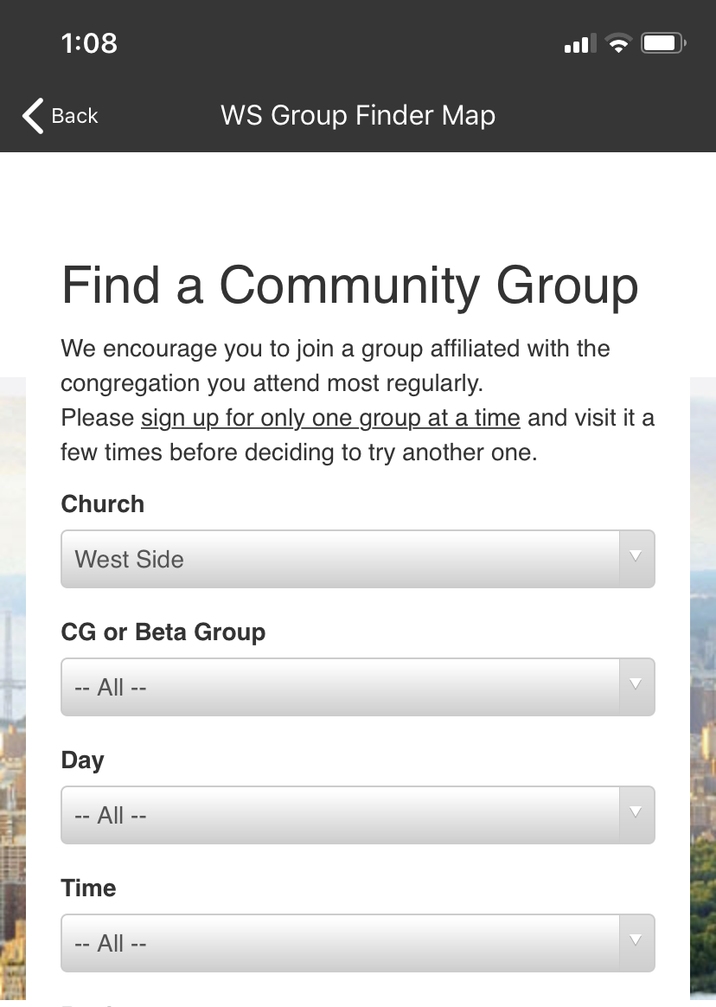
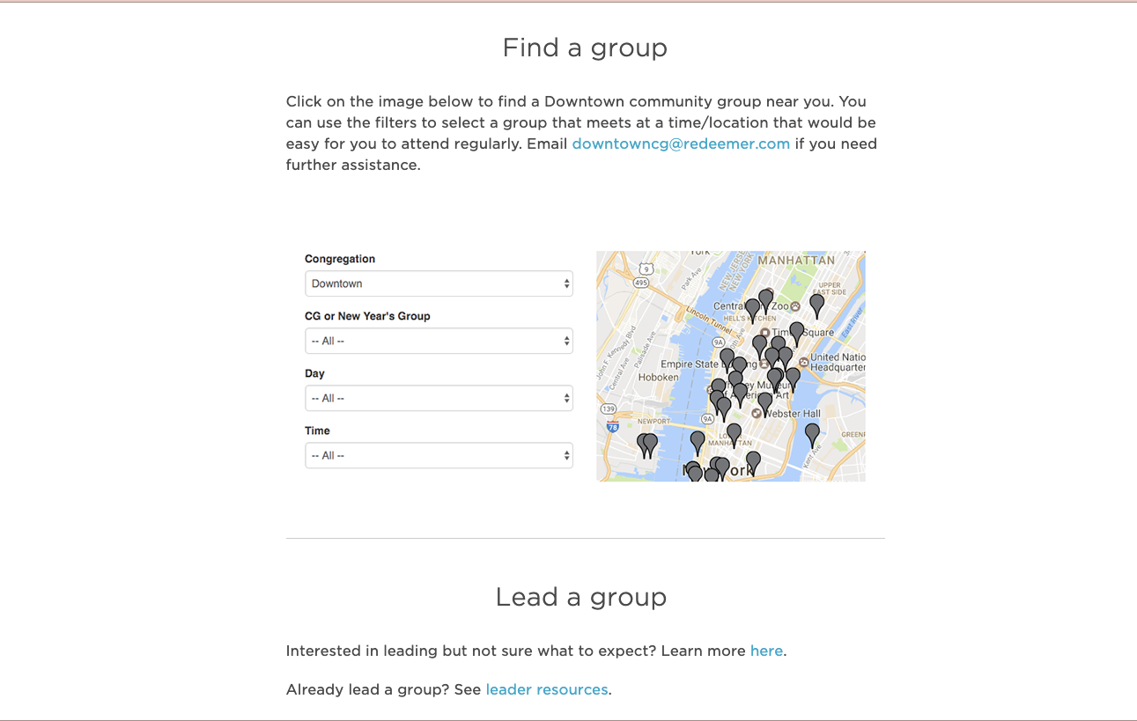
DEEPLINKING

Slide 48
Push Notifications

Slide 49
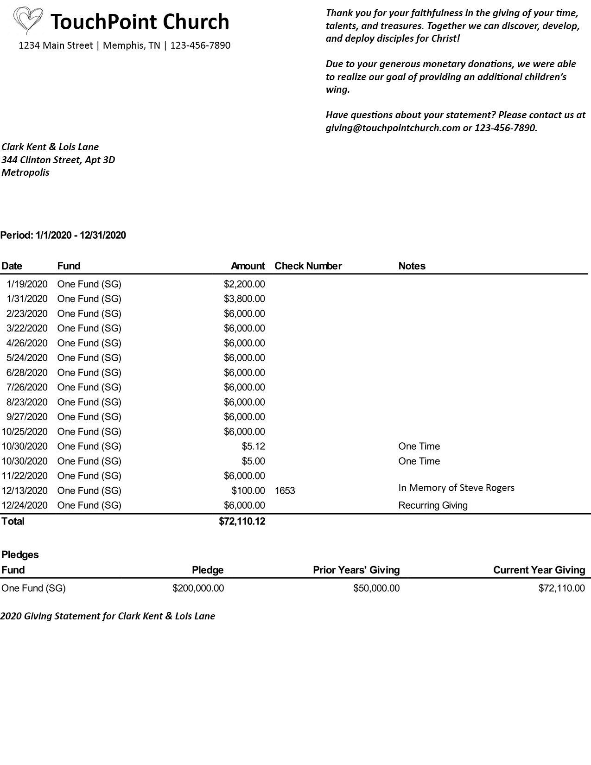
Giving Statement

Slide 50
Review The Data Regularly
“You can’t manage what you can’t measure.”
- Peter Drucker

Slide 51
SPECIAL OFFER
For TouchPoint Churches
Receive MortarStone Giving Analytics
& Strategies for FREE!
Visit MortarStone.com/TouchPoint-2
to Sign Up Today!
Notes:
http://MortarStone.com/TouchPoint-2

Slide 52
Q&A
touchpointsoftware.com • 1-888-788-6348

Slide 53
touchpointsoftware.com • 1-888-788-6348

